Slide 1
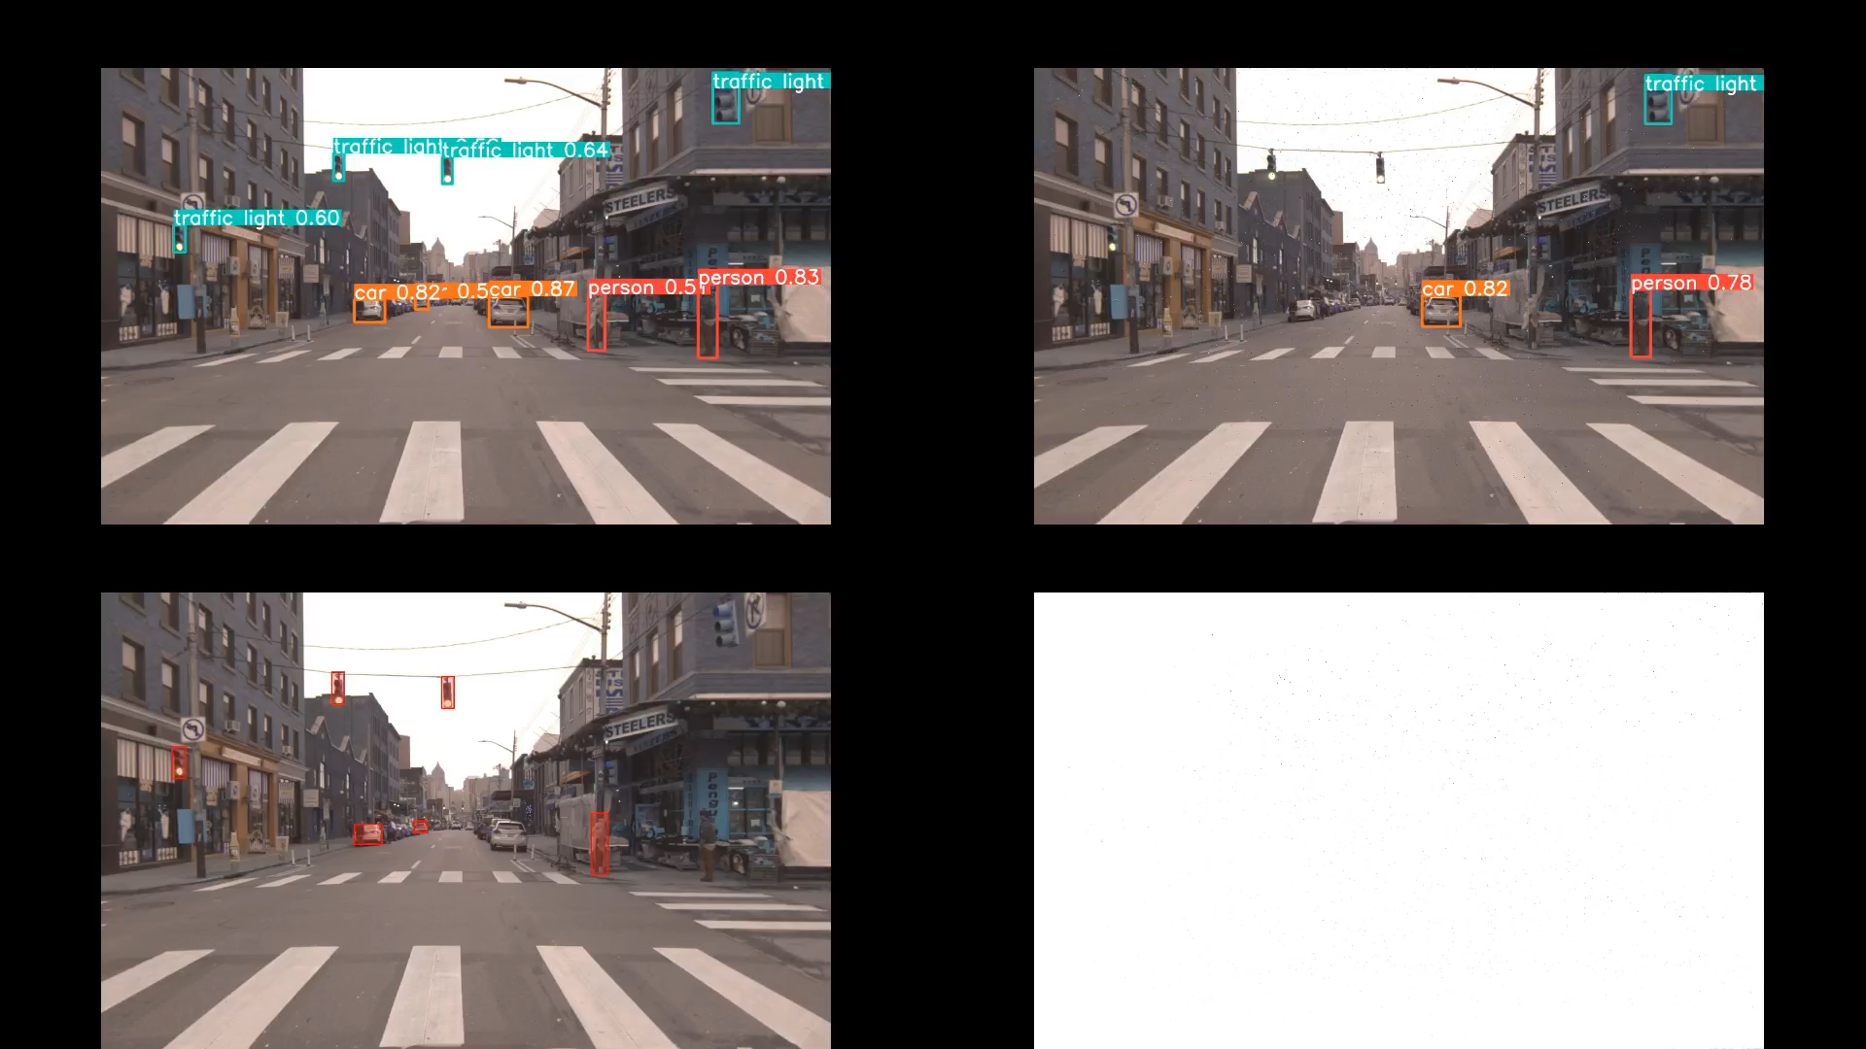
Original
Adversarial attack
Undetected Objects
Noise

